Slide 1

Evolutionary Dynamics and Coordination in Strategic Games
A comparative analysis of Rock-Paper-Scissors, Chicken, Battle of the Sexes, and Stag Hunt through the lens of evolutionary game theory.

Slide 2
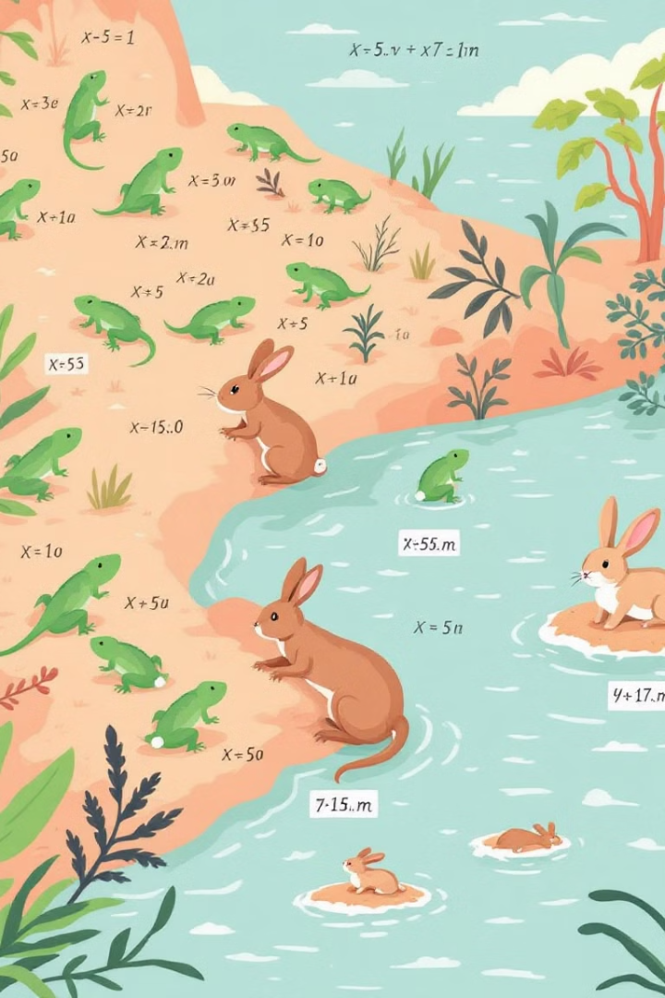

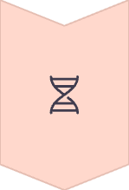

Evolution & Strategic Interaction
Evolutionary Game Theory Lens
Examines coordination through population dynamics. Reveals emergent behaviors across time.
Natural Selection Meets Strategy
Fitness depends on strategic choices. Better strategies increase representation.
Risk Dominance Connection
Straub's 1995 work links risk assessment to evolutionary outcomes. Explains non-optimal equilibria.

Slide 3




Why Study These Games?
Understand Cyclic vs. Convergent Behavior
Explore Risk vs. Payoff Dynamics
Safety often trumps optimality. Risk-aversion shapes evolutionary trajectories.
Some games never reach stable equilibrium. Others converge to predictable states.
Inform Algorithmic Design
Insights drive better coordination mechanisms.

Slide 4
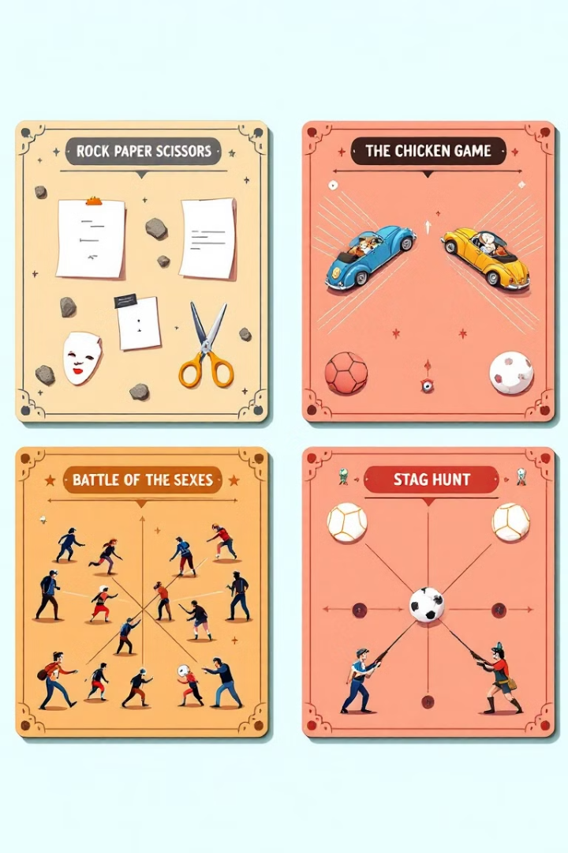
The Four Games - Overview
Rock-Paper-Scissors
Cyclic, neutrally stable dynamics. No dominant strategy exists.
Chicken
Tension between aggression and yielding. Mutual aggression causes worst outcome.
Battle of the Sexes
Asymmetric coordination challenges. Both prefer to coordinate differently.
Stag Hunt
Coordination dilemma between high reward and safe choice.

Slide 5






Rock-Paper-Scissors
Paper
Beats rock, loses to scissors. Maintains the non-convergent cycle.
Rock
Beats scissors, loses to paper. Creates fundamental cyclic dynamic.
Scissors
Beats paper, loses to rock. Completes the strategy cycle.
Payoff matrix creates unique equilibrium at (1/3, 1/3, 1/3). Replicator equation shows endless cycling around this point.

Slide 6
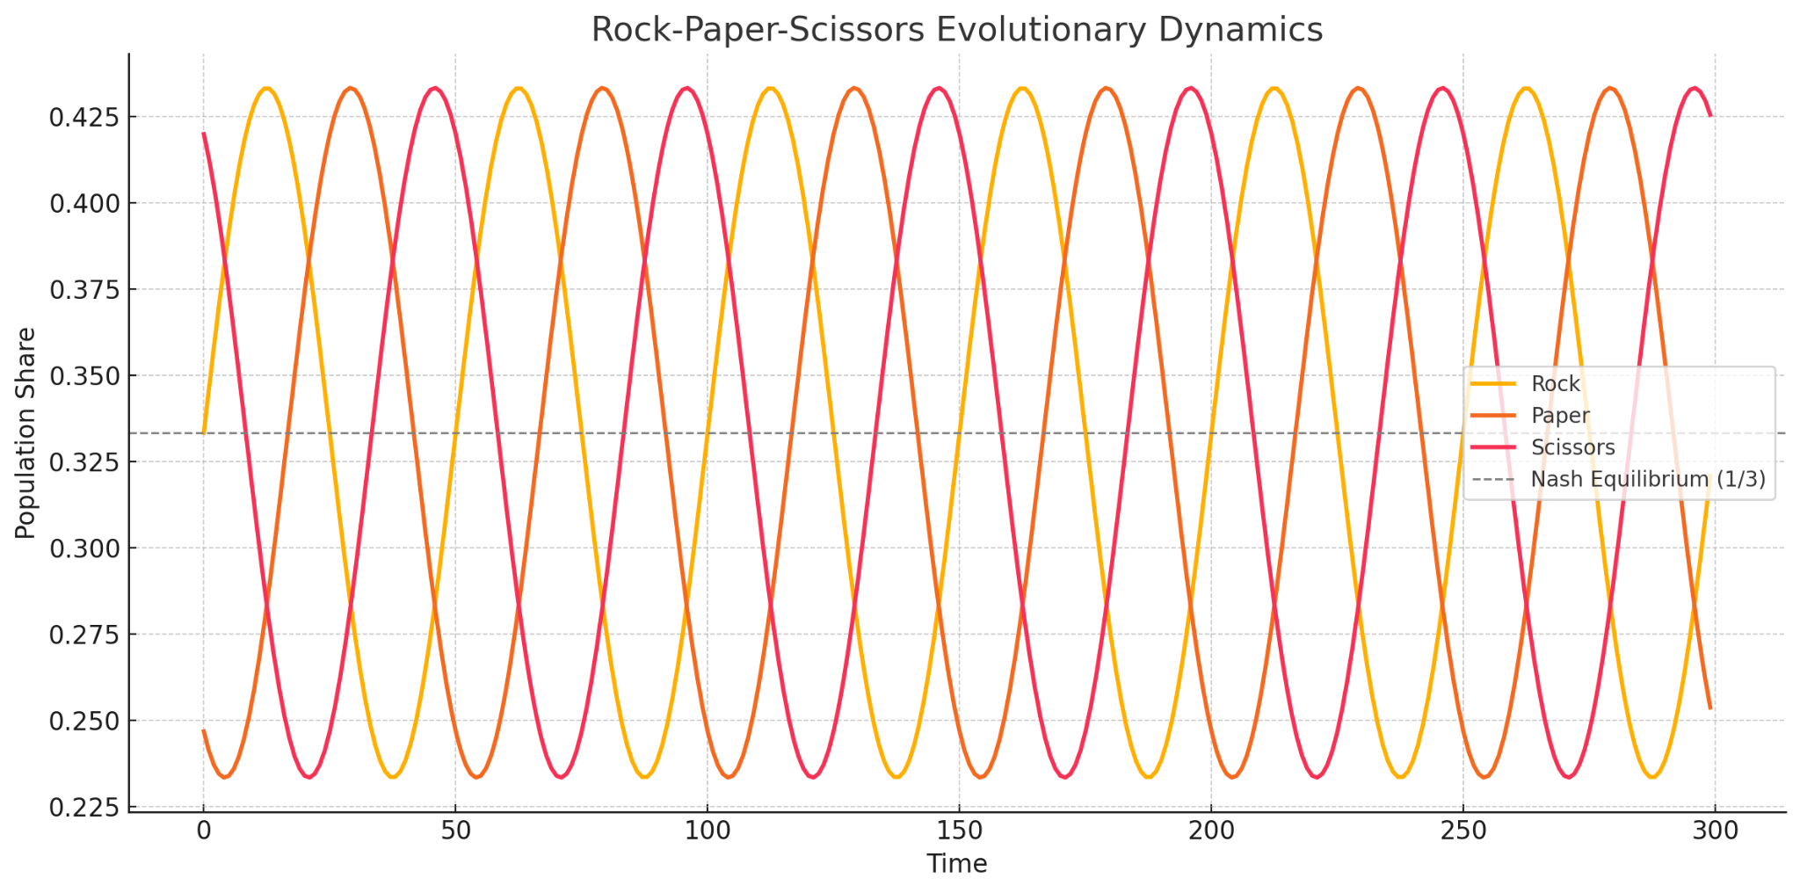
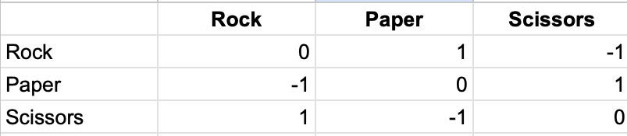
Rock-Paper-Scissors

Slide 7






Chicken - Risk & Response
Mutual Aggression
Catastrophic outcome for both players
Unilateral Aggression
Victory for aggressor, submission for yielder
Mutual Yielding
Moderate payoff, risk-dominant strategy
Mixed equilibrium emerges with risk-dominant selection. Replicator dynamics show high sensitivity to small payoff adjustments.

Slide 8
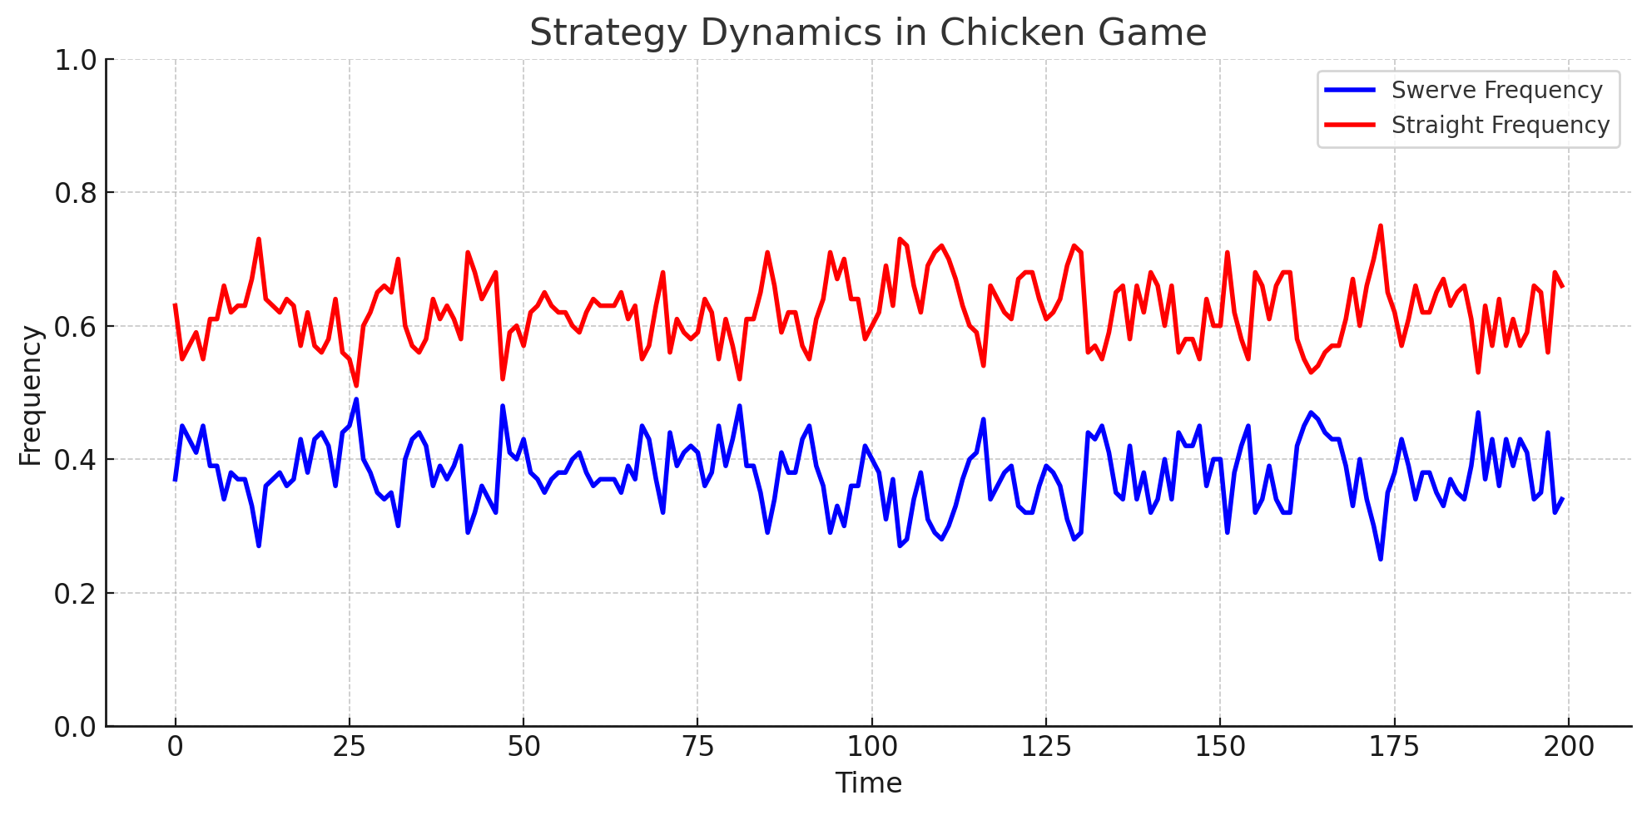
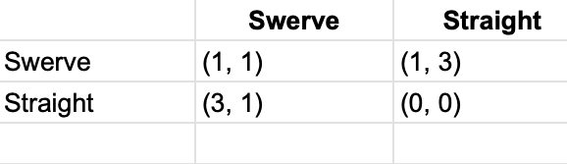
Chicken - Risk & Response

Slide 9



Battle of the Sexes
Her preferred outcome
Higher payoff for her, lower for him
Mixed strategy uncertainty
Arises from coordination challenge
His preferred outcome
Higher payoff for him, lower for her
Two pure Nash equilibria exist. Each player prefers a different one. Initial conditions strongly influence final outcomes.

Slide 10
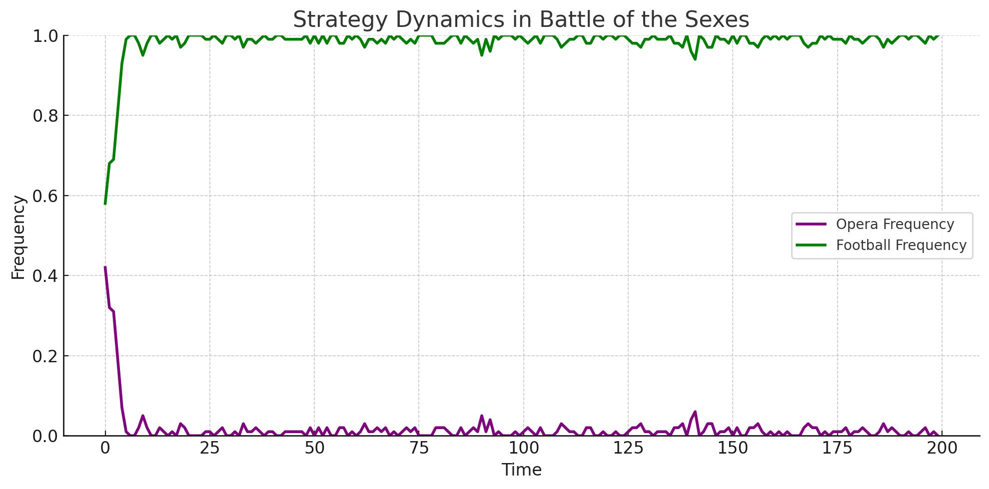
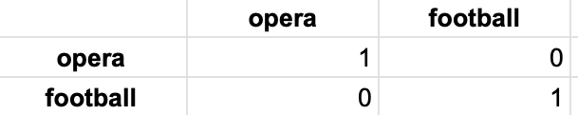
Battle of the Sexes

Slide 11
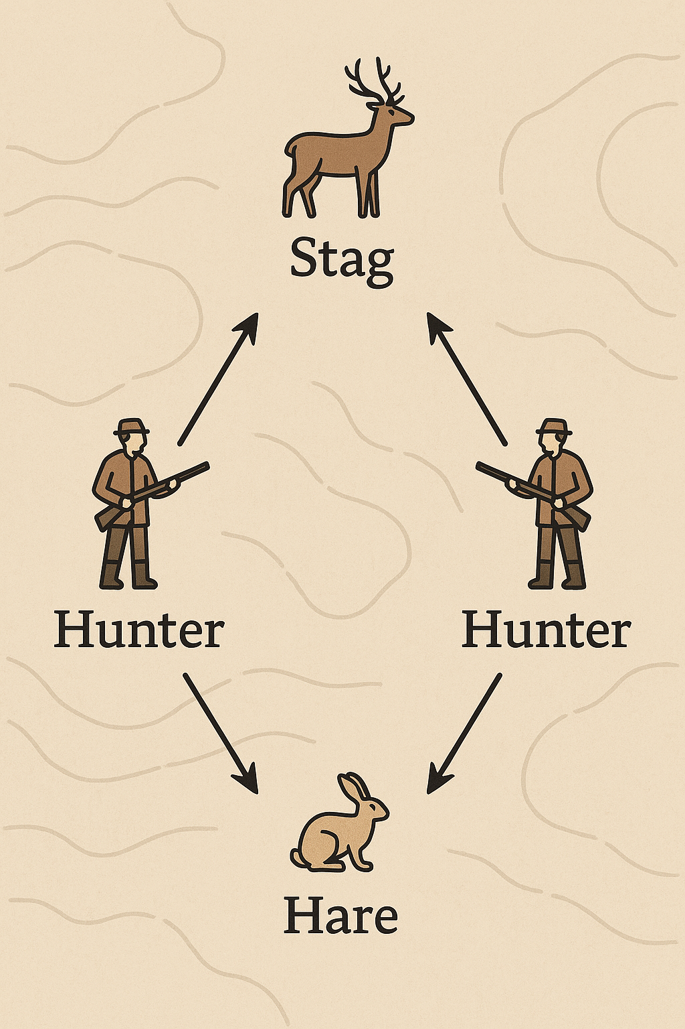
Stag Hunt
Hare Strategy
Risk-dominant choice. Guarantees minimum payoff. Lower maximum reward.
Safe regardless of partner's choice
Often dominates in evolutionary settings
Stag Strategy
Payoff-dominant choice. Requires mutual coordination. Highest reward potential.
High risk if partner chooses hare
Optimal when trust exists
Replicator equations show convergence may favor "safe" hare choice. Illustrates Straub's risk dominance concept.

Slide 12
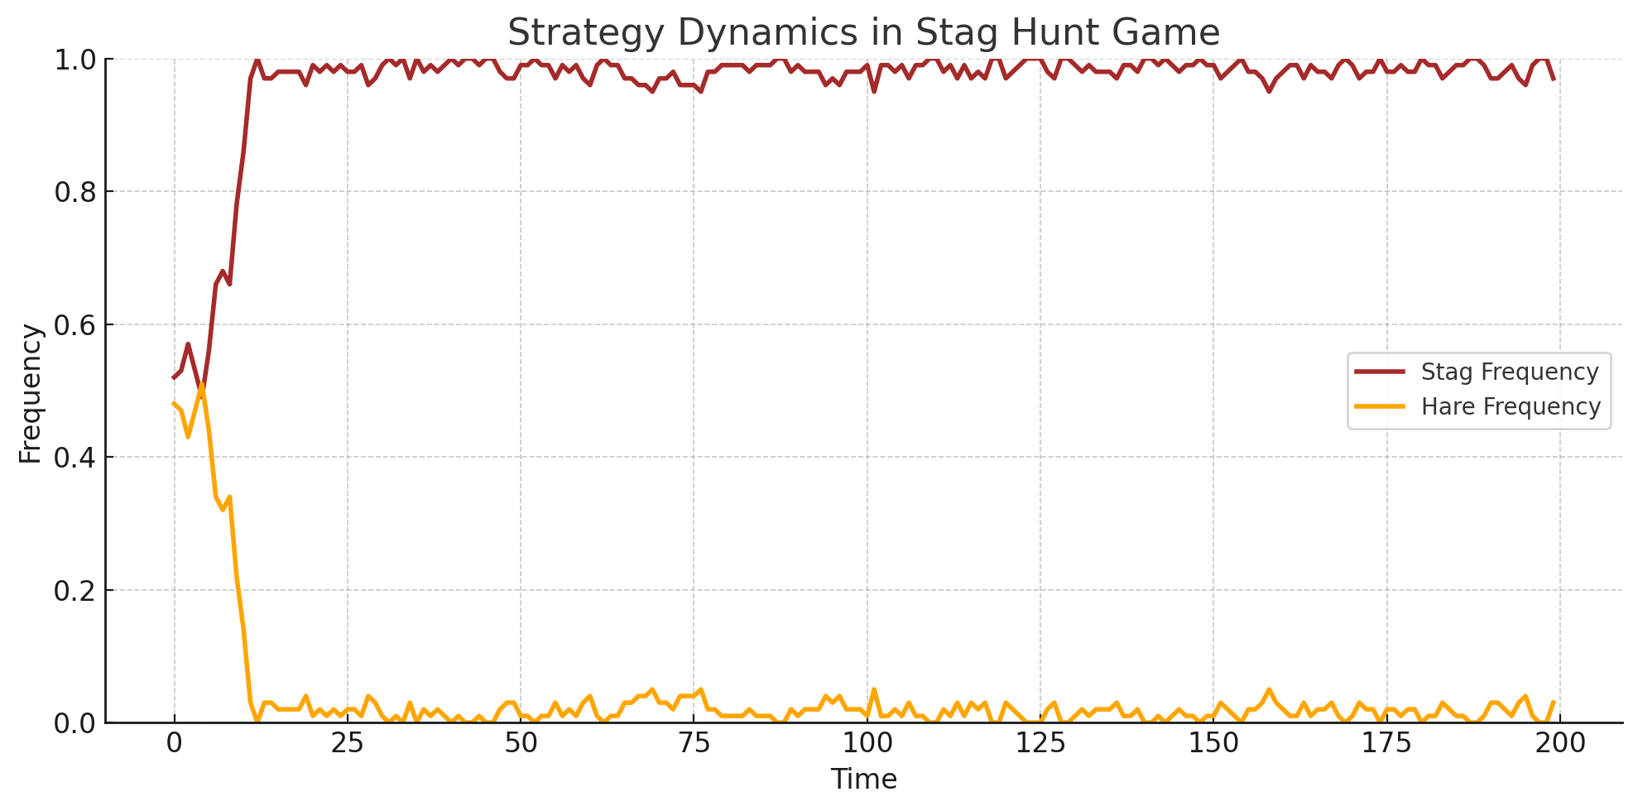
Stag Hunt - Coordination Dilemma
 | Stag | Hare
Stag | 4 | 0
Hare | 2 | 2

Slide 13
Comparative Insights
Rock-Paper-Scissors: Exhibits continual strategy cycles with neutral stability. No dominant strategy emerges in evolutionary dynamics.
Chicken: Demonstrates mixed equilibria highly sensitive to risk parameters. Small payoff adjustments create significant behavioral shifts.
Battle of the Sexes: Asymmetry creates inherent coordination challenges. Initial conditions strongly influence which equilibrium prevails.
Stag Hunt: Illustrates tension between optimal (payoff-dominant) outcomes and safer (risk-dominant) choices. Trust determines evolutionary path.
These diverse games reveal how different payoff structures drive vastly different evolutionary outcomes.

Slide 14
Conclusion & Future Directions
Evolutionary Perspective: Game dynamics illuminate why coordination failures persist in natural systems despite selective pressure
Risk Dominance: Straub's concept explains why suboptimal equilibria often prevail over payoff-dominant ones
Practical Applications: These insights directly inform algorithm design, multi-agent systems, and social coordination mechanisms
Future Research: testing if a strategy type gives one an advantage in most games, how people’s game tendencies reflect in everyday decision making.
Resources: See references (Straub, 1995; course texts; supplemental materials) for deeper exploration

